Slide 1
Secure data hiding in images using steganography
CAPSTONE PROJECT
Presented By: Cheedella Venkata Sai Lakshmi Bhavana
Student Name : Cheedella Venkata Sai Lakshmi Bhavana
College Name & Department : PBR Visvodaya Institute of Technology and Science & Computer Science and Engineering

Slide 2
OUTLINE
Problem Statement
Technology used
Wow factor
End users
Result
Conclusion
Git-hub Link
Future scope

Slide 3
Problem Statement
In today’s digital world, ensuring secure communication is essential for safeguarding sensitive information from unauthorized access.
While traditional encryption methods are effective, they can often be detected and may draw unwanted attention.
This project focuses on the need for covert communication by utilizing steganography, a technique that conceals text messages within images.
The tool guarantees that the hidden data remains unnoticed while adding an extra layer of security with passcode protection.
This method allows users to share confidential information in a discreet and secure manner.

Slide 4
Technology used
Programming Language : Python
Libraries :
OpenCV (cv2): Used for image processing.
customtkinter: Utilized for building a modern graphical user interface.
CTkMessagebox: For displaying user-friendly messages.
Platforms :
Compatible with Windows, Linux, and MacOS (cross-platform support).

Slide 5
Wow factors
Unique Features :
User-friendly graphical interface designed with customtkinter.
Passcode protection guarantees that only authorized users can decrypt messages.
Simple yet effective pixel manipulation technique for embedding messages.
Compatible with lossless image formats such as PNG to maintain hidden data integrity.
Standout Factor :
Combines steganography with passcode-based security, making it more robust than basic steganography tools.

Slide 6
End users
The end users include:
Students and educators interested in learning about steganography.
Individuals looking for secure ways to communicate.
Developers who are experimenting with techniques for hiding data in images.

Slide 7
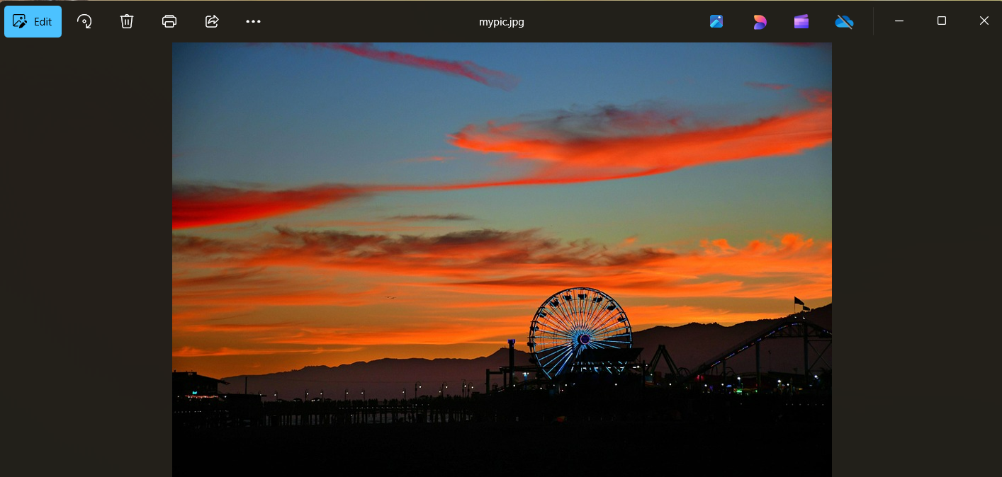
Results

Slide 8
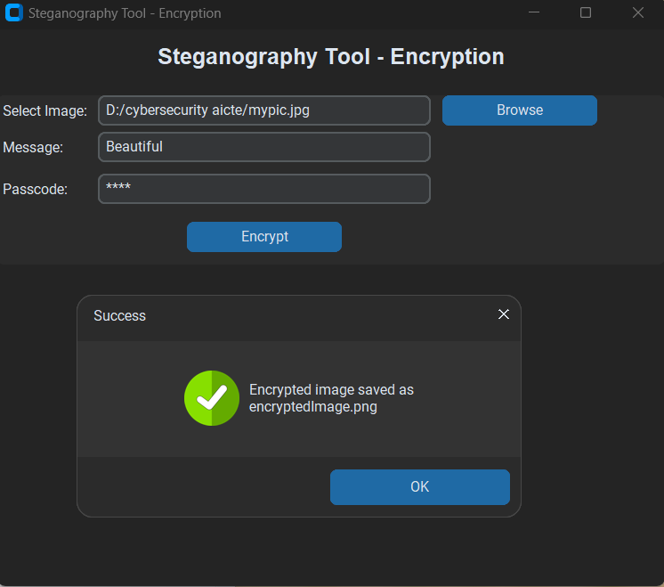
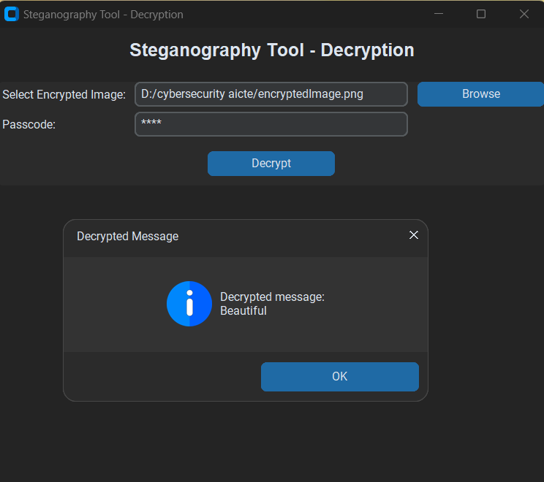
results

Slide 9
Conclusion
The Steganography Tool effectively tackles the challenge of secure communication by embedding text messages within images, allowing for discreet and undetectable data sharing.
It offers a straightforward yet powerful method for concealing and retrieving sensitive information, while also including passcode-based security for extra protection.
This project lays the groundwork for grasping steganography and its real-world applications.
Future improvements could enhance its robustness and broaden its range of use cases, making it a flexible tool for secure communication.

Slide 10
GitHub Link
GitHub Repository: https://github.com/Bhavanach379/PyStego.git

Slide 11
Future scope(optional)
Implement advanced steganography techniques, such as least significant bit (LSB) with error correction.
Include support for encrypting larger files, like documents or audio.
Enhance security by incorporating hashing and salting for the passcode.
Make the tool cross-platform and more robust.

Slide 12
THANK YOU

